Slide 1
Data Driven Business Decisions Made Easy
Powered by Red Hat JBoss Middleware
JBoss BRMS v6
JBoss DV v6

Slide 2
Agenda
Data-driven business decisions - a customer service example
Providing context with JBoss Middleware
  JBoss BRMS
  JBoss Data Virtualization
Demo

Slide 3


A Customer Service Example
Data Warehouse
Call Center Agents
CRM
Billing
Transaction History
Accounts

Slide 4
A Customer Service Example
Customer calls in…
Data Warehouse
Call Center Agents
CRM
Billing
Transaction History
Accounts

Slide 5
A Customer Service Example
Customer calls in…
What do we know about this customer?
Records?
History?
Recent activity?
Data Warehouse
Call Center Agents
CRM
Billing
Transaction History
Accounts

Slide 6
A Customer Service Example
Customer calls in…
What is the likely intent of this inquiry?
Complain?
Buy more product?
Terminate service?
Modify service?
Data Warehouse
Call Center Agents
CRM
Billing
Transaction History
Accounts

Slide 7
A Customer Service Example
Customer calls in…
What are likely next best actions??
Discount?
Replacement product?
Upgrade?
Data Warehouse
Call Center Agents
CRM
Billing
Transaction History
Accounts

Slide 8
2 Steps to Improving Customer Service
Provide a complete customer context
  Structured data, likely from various data stores
  Unstructured data
  Historical data
    Long term from data warehouse
    Recent activity
  Data from outside the organization
    Tweets
    Posts on social media

Slide 9
2 Steps to Improving Customer Service
Infer action from context
  Determine likely intent
  Identify paths to resolution
Notes:
Example: Context indicates recent increase in international calls, recent rise in charges.
Intent: remove charges, possible churn risk
Offer: free international calling plan, free phone upgrade

Slide 10


Better Decisions with JBoss Middleware
Infer action
Build context from disparate data

Slide 11


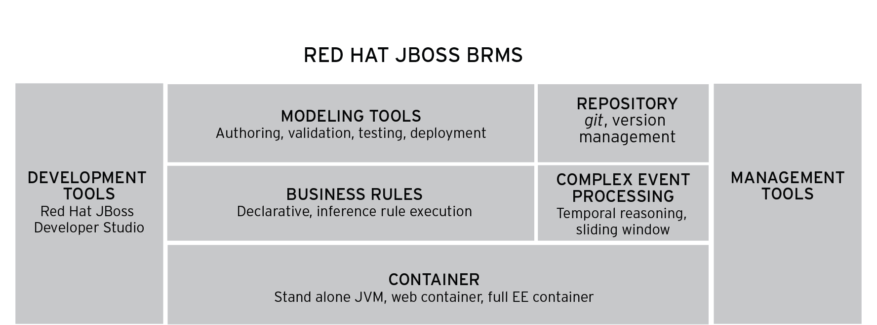



A single, integrated, certified distribution for Business Rules Management and Complex Event Processing, based on open source community projects:

Slide 12
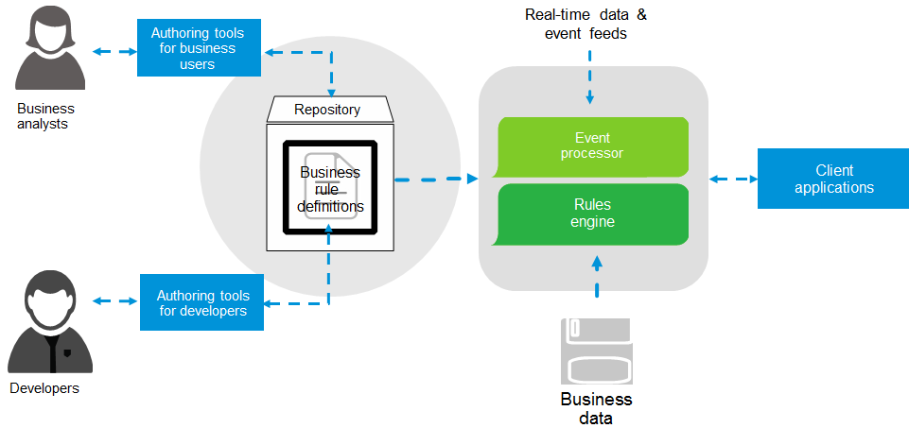
BRMS Components

Slide 13
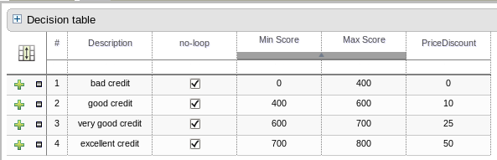
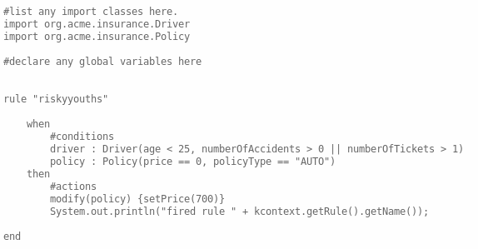
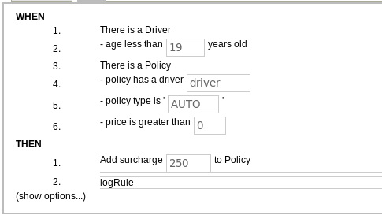
Rules

Slide 14
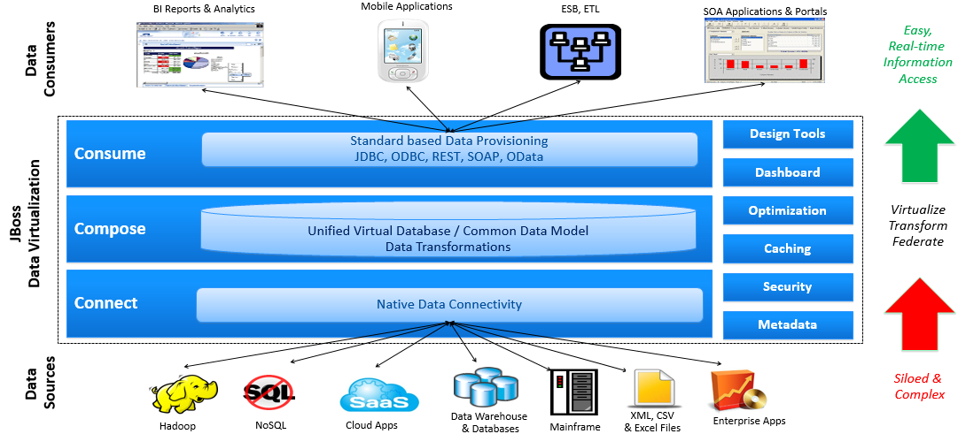
Red Hat JBoss Data Virtualization
Complete View of Master and Transactional Data in Real-time
Notes:
The data virtualization software provides 3 step process to connect data sources and data consumers:
● Connect: Fast Access to data from disparate systems (databases, files, services, applications, etc.) with disparate access method and storage models.
● Compose: Easily create reusable, unified common data model and virtual data views by combining and transforming data from multiple sources.
● Consume: Seamlessly exposing unified, virtual data model and views available in real-time through a variety of open standards data access methods to support different tools and applications.
JBoss Data Virtualization software implements all three steps internally while isolating/hiding complexity of data access methods, transformation and data merge logic details from information consumers.
This enables organization to acquire actionable, unified information when they want it and the way they want it; i.e. at the business speed.

Slide 15
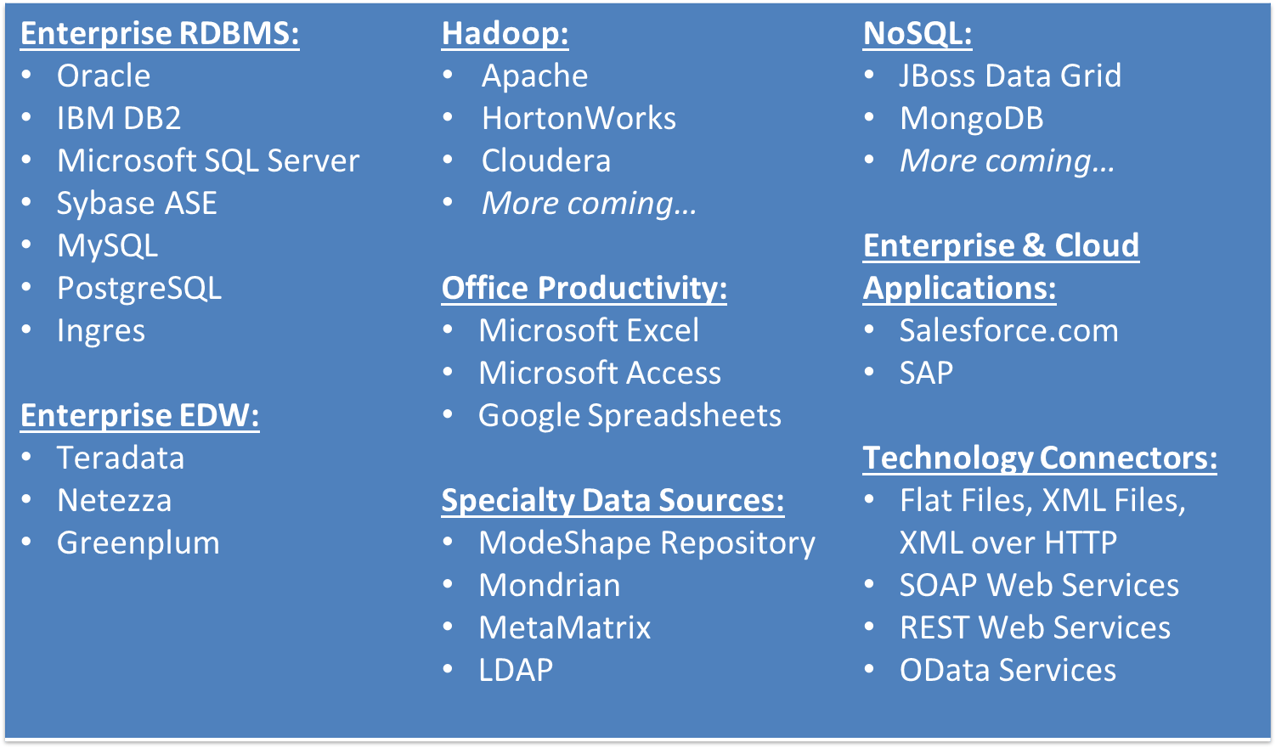
JBoss Data Virtualization - Supported Data Sources

Slide 16
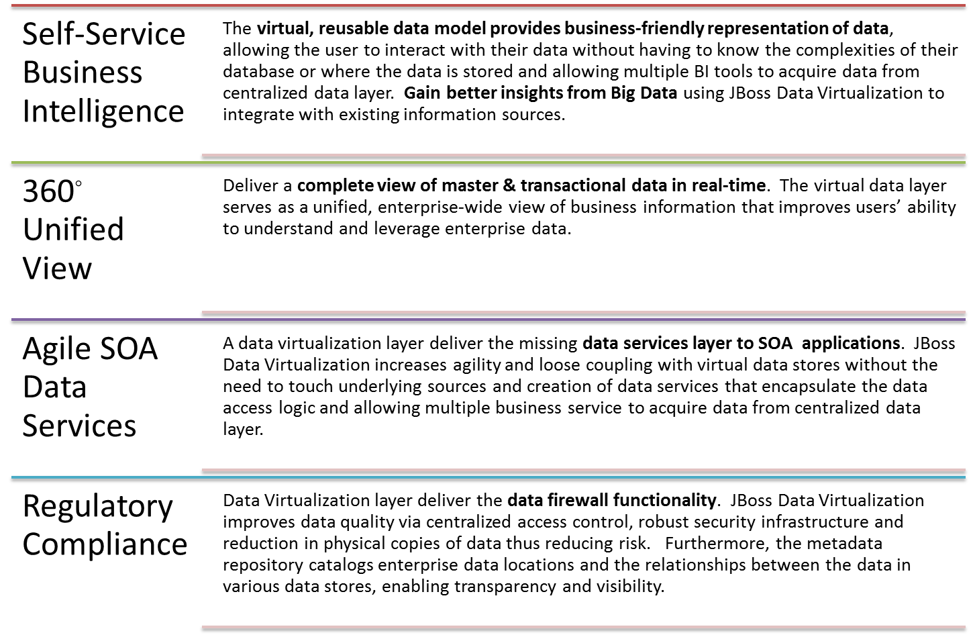
JBoss Data Virtualization – Use Cases

Slide 17
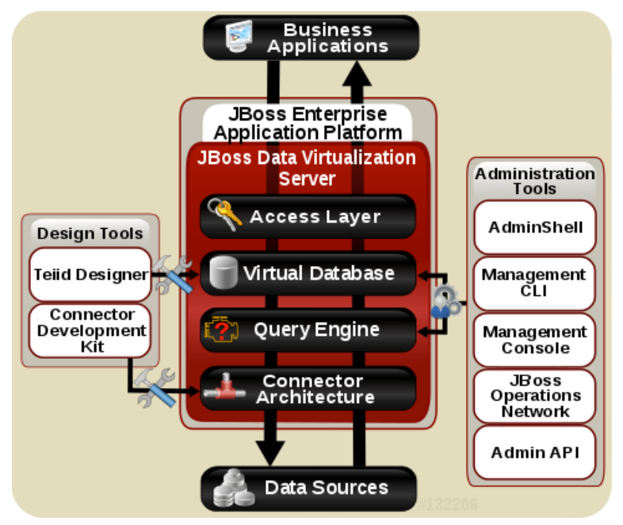
JBoss Data Virtualization – Architecture
Notes:
Query Engine
The heart of Red Hat JBoss Data Virtualization Server is a high-performance query engine that processes relational, XML, XQuery and procedural queries from federated datasources. Features include support for homogeneous schemas, heterogeneous schemas, transactions, and user defined
Embedded JDBC
An easy-to-use JDBC Driver that can embed the Query Engine in any Java application.
Server
An enterprise ready, scalable, manageable, runtime for the Query Engine that runs inside JBoss EAP that provides additional security, fault-tolerance, and administrative Features.
Connectors
Red Hat JBoss Data Virtualization Server includes a rich set of Translators and Resource Adapters that enable access to a variety of sources, including most relational databases, web services, text files, and ldap. Need data from a different source? A custom translators and resource adaptors can easily be developed.
Tools
Red Hat JBoss Data Virtualization Server includes development and administration tools
• Create - Use Teiid Designer to define virtual databases containing views, procedures or even dynamic XML documents.
• Monitor & Manage - Use the Management Console with JBoss EAP or use the JBoss Data Virtualization Jboss Operations Network (JON) plugin to control any number of servers.
• Script - Use the AdminShell to automate administrative and testing tasks.

Slide 18
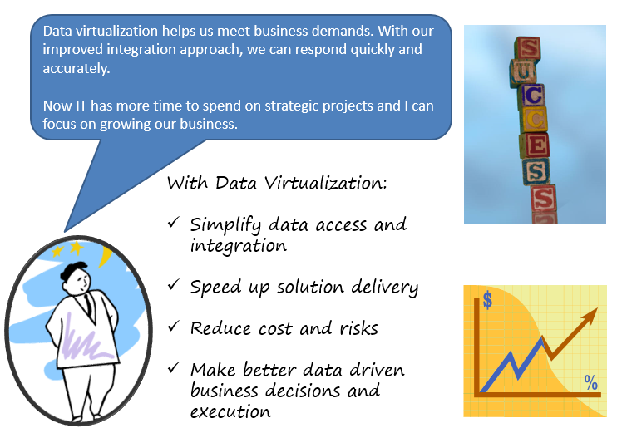
JBoss Data Virtualization – Benefits

Slide 19






JBoss Architecture for Context & Actions
Call Center Agents
Actions
Offers
Recommendations
Customer Context
Rules
Application
That uses BRMS
Knowledge
Session and DV VDB
CRM
Transaction
History
Feedback
Third Party
REST/SOAP API
or from Hadoop
Twitter REST API
or from Hadoop
Data
Warehouse

Slide 20
JBoss Data Virtualization – Use Case
Objective:
Determine what offers or discounts can be offered to the customer according to the customer context
Problem:
Call center agents don't have easy access to all the data and the business rules are manual
Solution:
Use DV to create a unified view for a customer context which can then be applied to business rules in BRMS to automatically determine the offers or discounts for the customer

Slide 21
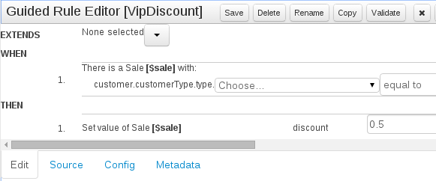
Demonstration with DV and BRMS
Customer 1 – Tom BAD Smith
With 450 Credit Score, Cold Sentiment, 2 calls
Customer 2 – Bryan VIP Jacobs
With 750 Credit Score, Warm Sentiment, 7 calls
Customer 3 – Michelle VIP Ramos
With 650 Credit Score, Hot Sentiment, 2 calls
Customer 4 – Tina REGULAR Romney
With 705 Credit Score, Cold Sentiment, 4 calls
Rule "BadCustomerSale" – When the Customer type on the sale is bad then sale is denied
Rule “RegularSale” - When the Customer type is regular the sale is approved
Rule “VipDiscount” - When the Customer type is VIP then the discount is .5 and sale is approved

Slide 22
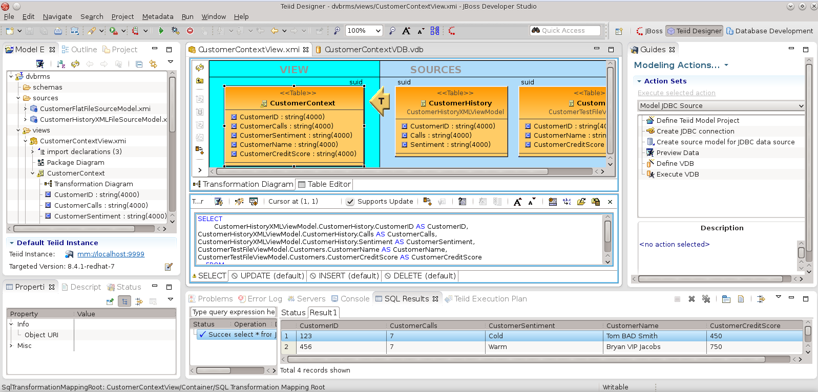
Demonstration – DV Designer

Slide 23
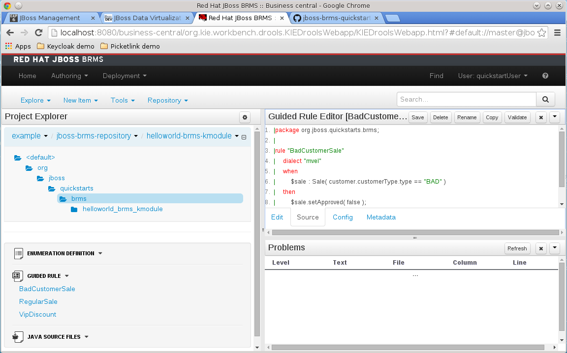
Demonstration – BRMS Business Central

Slide 24
Thank you!

Slide 25
Data Driven Business Decisions Made Easy
Part IV – Run
Powered by Red Hat JBoss Middleware
JBoss BRMS v6
JBoss DV v6

